Slide 1
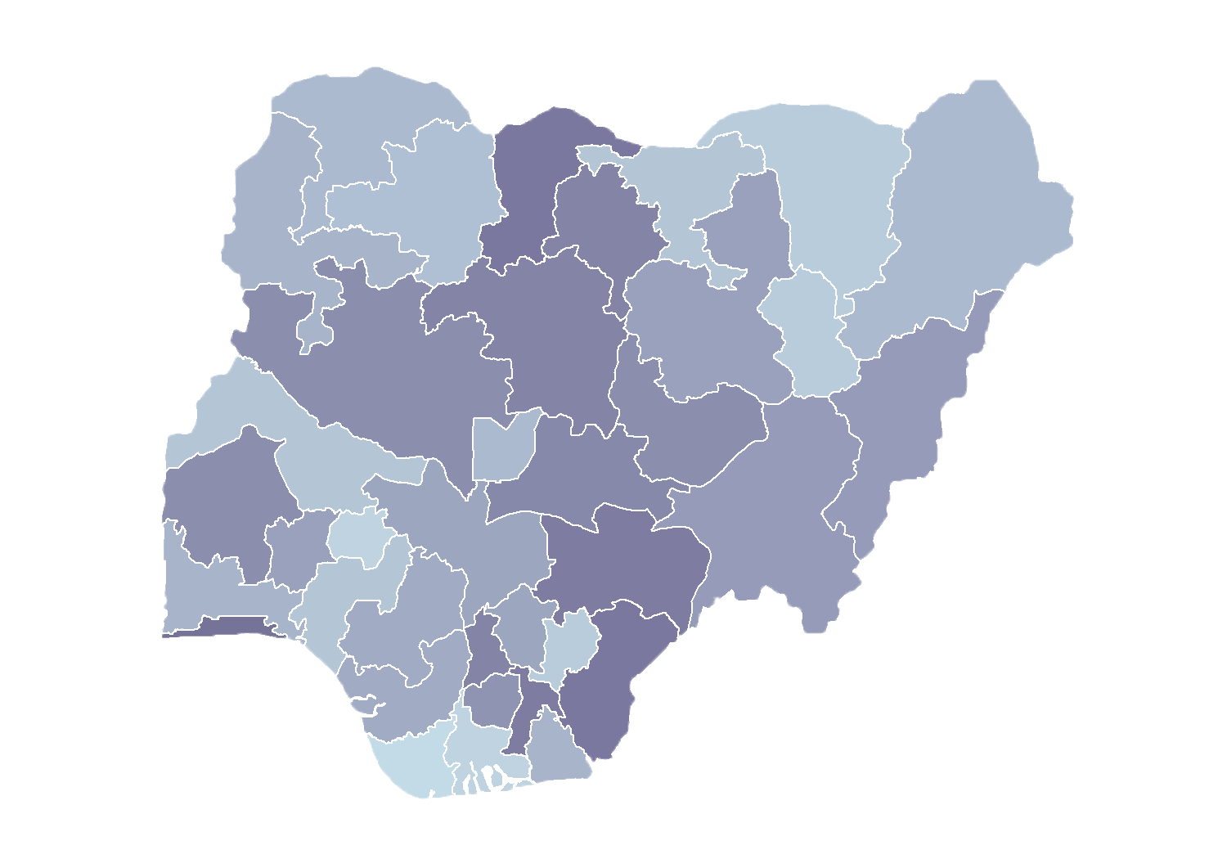
Module 1.3
Demonstration of the
Health Facility Registry
Rollout of Health Facility Registry/Master Facility List for States and Local Government Areas in Nigeria
March 2019

Slide 2
Outline
Introduction
Home menu
Statistics
Facilities list
Data downloads
Resources
Activity

Slide 3
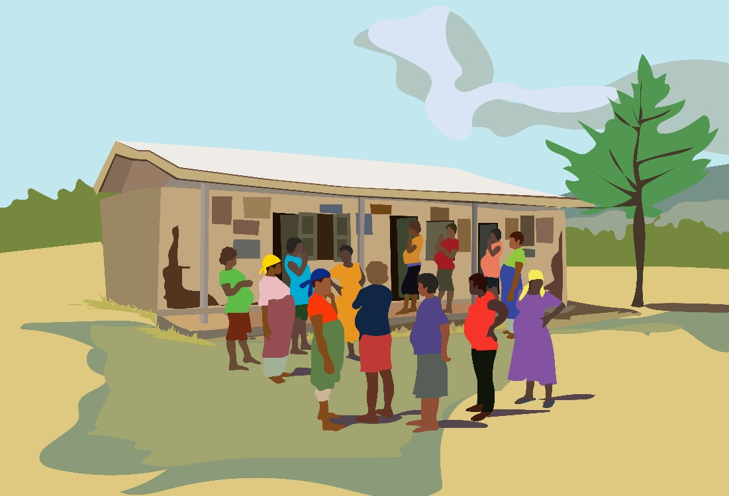
Home

Slide 4
Introduction
https://hfr.health.gov.ng

Slide 5
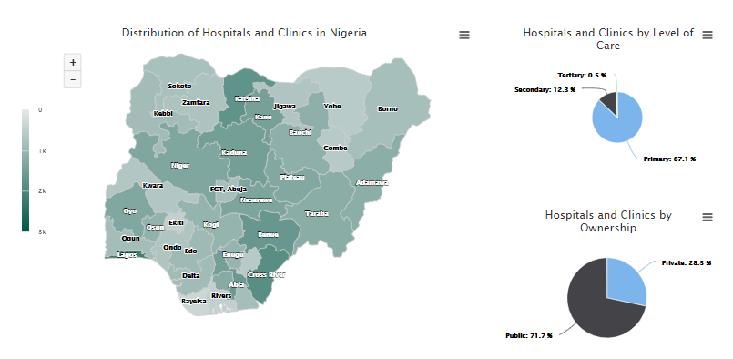
Home
1
2
3
Shows hospitals and clinics in each state
Shows hospitals and clinics by level of care
Shows hospitals and clinics by ownership

Slide 6
Home
Shows percentage of hospitals and clinics with geocoordinates

Slide 7
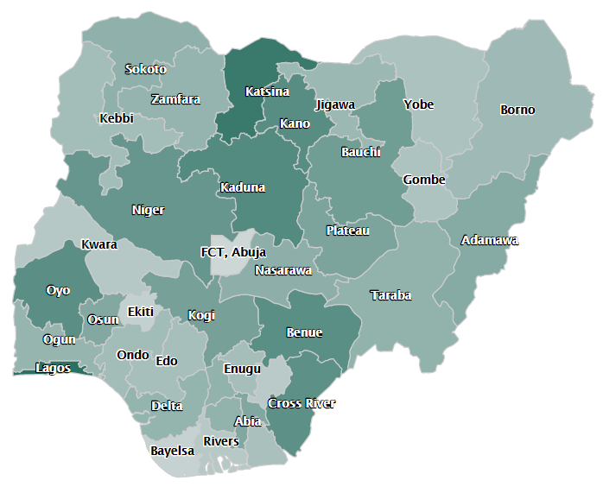
Home – map
Interactive map displaying facility density
Which two states have the highest number of facilities?
To view state map details, click on it
(e.g., Abia)
Notes:
Q1: Lagos (2,167) and Cross River(1,843)

Slide 8
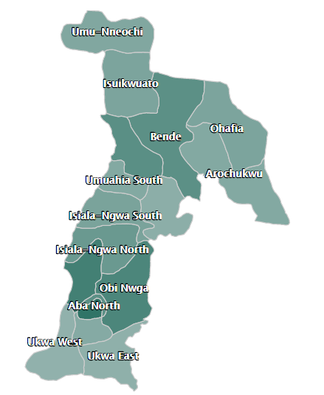
Home – map
Abia state
Which local government area (LGA) has the highest number of facilities?
To view LGA details, click on it
Notes:
Q1: Aba North (150)
Click on Obi Ngwa LGA to view details in a Google map

Slide 9
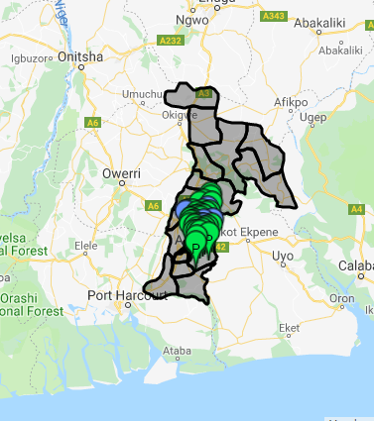
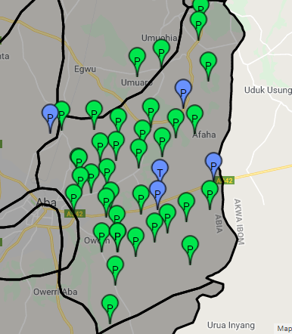
Home – map
Obi Ngwa LGA
Click on the facility to see details.
Notes:
The first map shows Abia state.
Use the zoom button to get a closeup of Obi Ngwa LGA.
Notice the different demarcations – what do you notice about the markers?
Green = public
Blue = private
P = primary
T = tertiary
S = secondary
Click on any facility to see the details of that facility.

Slide 10
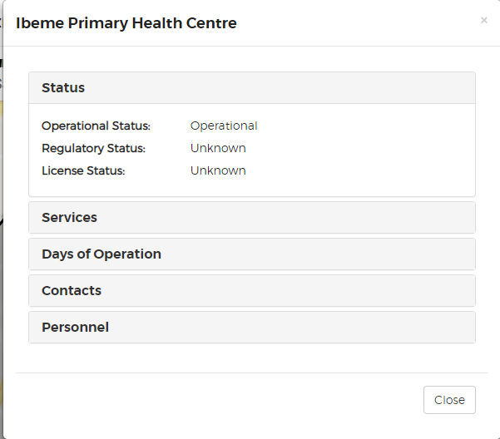
Home – map
Facility details on map

Slide 11
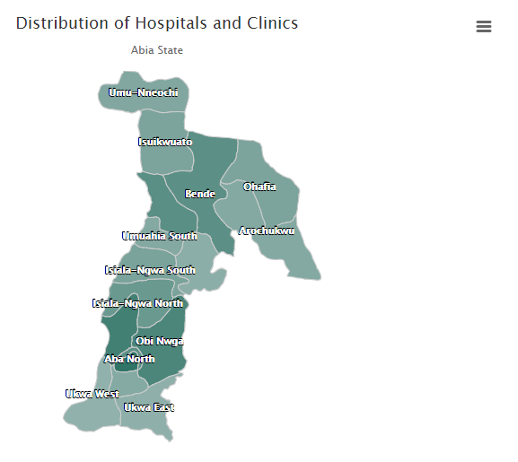
Quick tips
Download images
Anytime you see the three bars, click!
Available to print or download as PNG, JPEG, PDG, or SVG

Slide 12
Discussion questions
with the person sitting next to you
With this overview of the initial dashboard (found on the home menu) what are your initial reactions?
Does the data seem accurate? What potential problems can you identify?
What further questions do you want to ask of these data?

Slide 13
Statistics
Summary tables
Notes:
After looking at home page, let us go to statistics.
Statistics has three submenus:
Summary tables
Summary charts
Population index

Slide 14
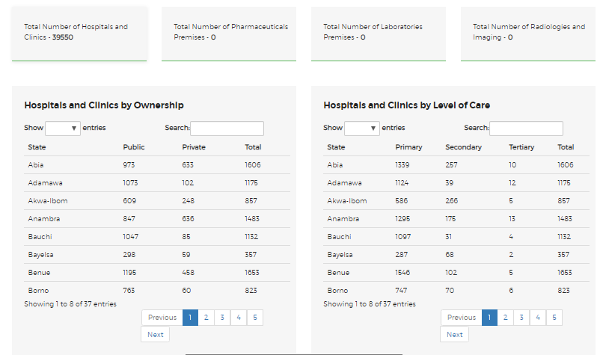
Summary tables

Slide 15
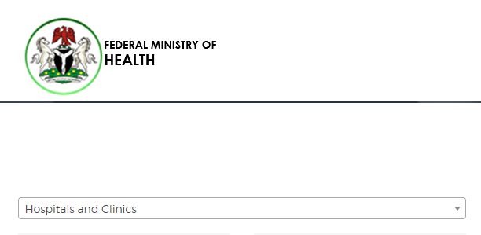
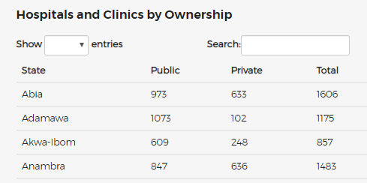
Summary tables
Abia state has 1,606 hospitals and clinics, broken down by public (973) and private (633)

Slide 16
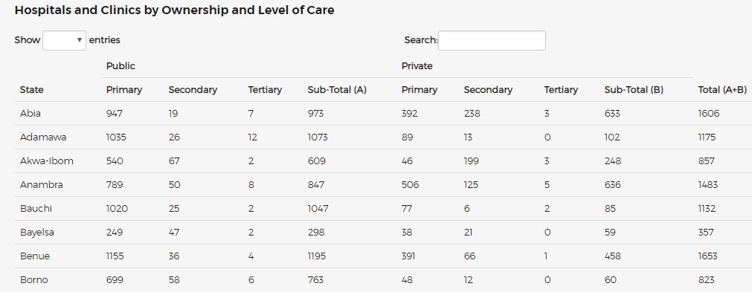
Summary tables cross-tab
Ownership and level of care

Slide 17
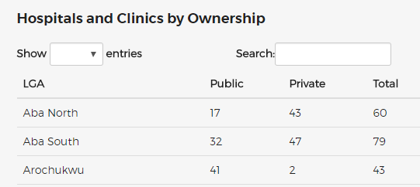
Summary tables – filter
To produce results by LGA!
Aba North LGA has 60 facilities, including public (17) and private (43)

Slide 18
Practical questions
How many hospitals/clinics in Abia?
How many hospitals/clinics in your LGA?
How many tertiary hospitals in Abia?
How many private secondary hospitals in Umuahia North LGA in Abia state?
Notes:
Q1 – 1,606
Q2
Q3
Q4

Slide 19
Statistics
Summary charts

Slide 20
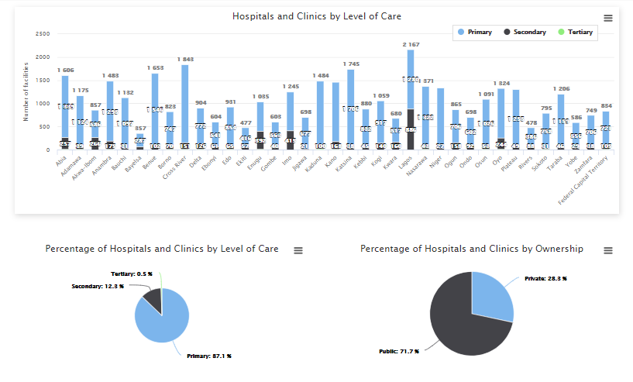
Summary charts

Slide 21
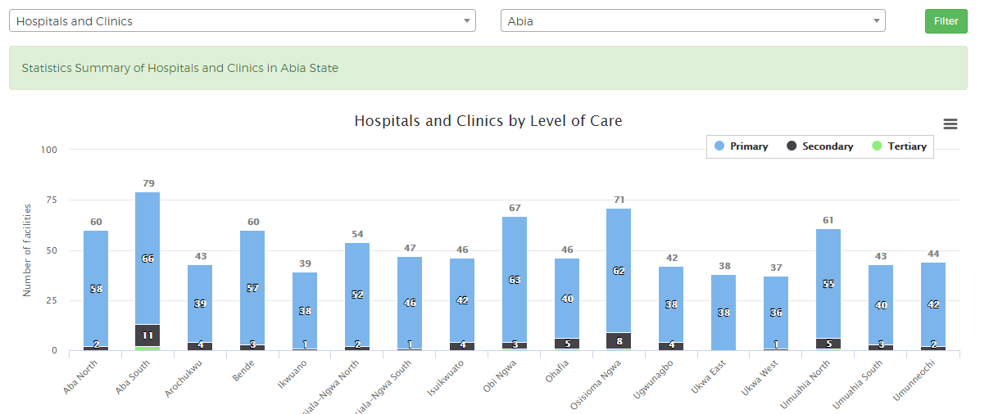
Summary charts – filter
by state level
Filter

Slide 22
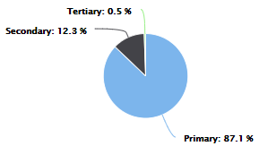
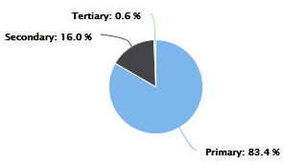
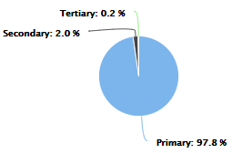
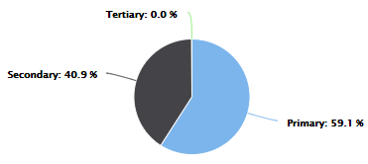
Summary charts – level of care
Nigeria
Abia state
Lagos state
Niger state
Notes:
Do these numbers look reasonable?
88.6% primary care
10.9% secondary care
0.5% tertiary care
What additional questions may you ask about level of care?
Does each state have one tertiary facility?
Does each state have one secondary facility?
Let’s explore other states:
Abia has a similar profile to Nigeria
Niger has almost exclusively primary facilities
Lagos has almost 40% secondary facilities, and again a small percent of tertiary facilities

Slide 23
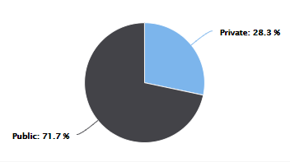
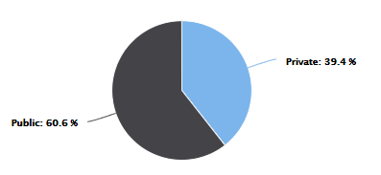
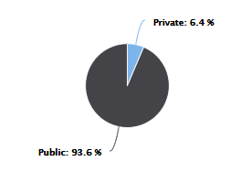
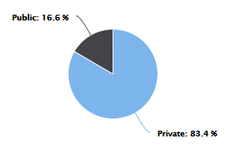
Summary charts – ownership
Nigeria
Abia state
Lagos state
Niger state
Notes:
Do these numbers look reasonable?
22.6% private
77.4% public
What additional questions may you ask about ownership?
Have all the private facilities been captures in the HFR?
What about non-registered private facilities? Are they in the HFR?
How are religious health facilities counted? Private or public?
Have all the health facilities in the HFR been classified as either private or public?
Let’s explore other states:
Abia has a similar profile to Nigeria
Niger has almost exclusively public facilities
Lagos has 83% private facilities and only 16.9% public facilities

Slide 24
Statistics
Population index

Slide 25
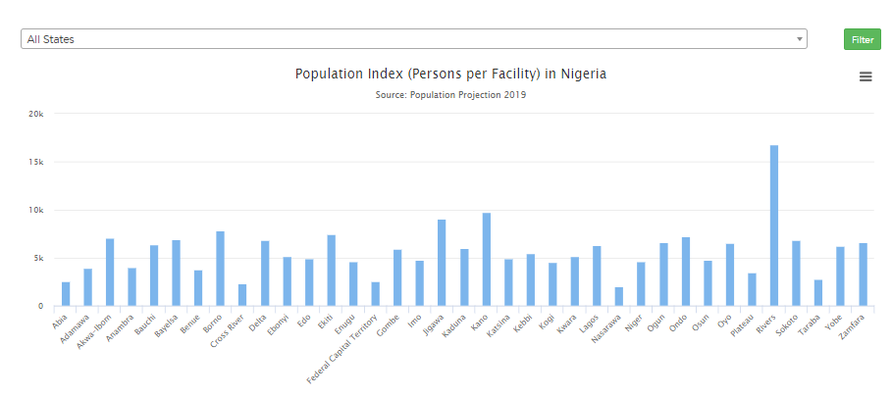
Population index
by state
Filter
Average number of people attended by each hospital/clinic

Slide 26
Facilities list

Slide 27
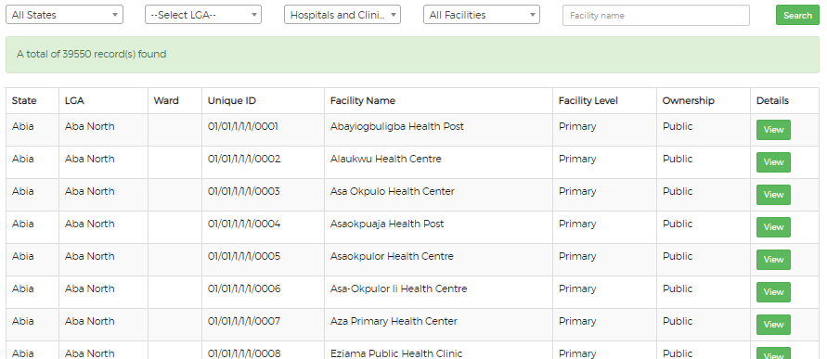
Facilities list
Click on the facilities list menu.

Slide 28
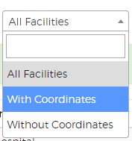
Facilities list – filter
1
2
3
4
Filter by state
Filter by LGA
Filter by facilities with or without coordinates
Filter by name

Slide 29
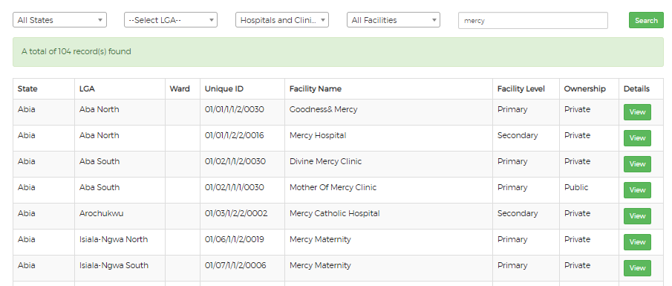
Facilities list – filter
Find Mother of Mercy Hospital
Click to view details
1
2

Slide 30
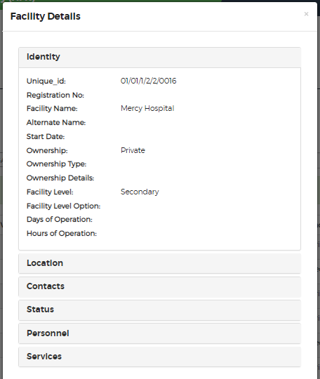
Facilities list – details

Slide 31
Data downloads

Slide 32
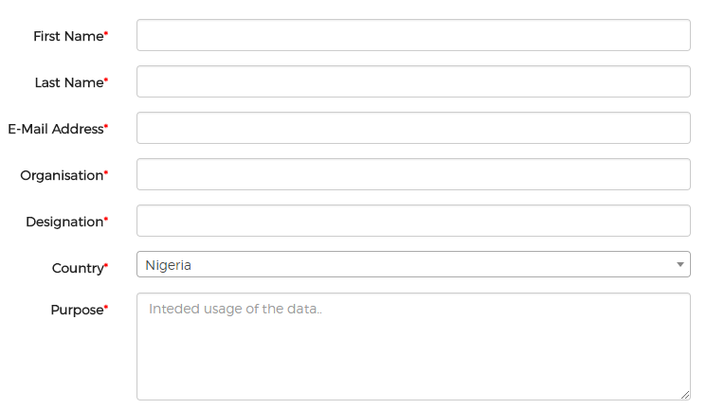
Data downloads
Thank you for your interest!
For those requiring download of data in Excel format,
please complete the form and you will receive access to download the data you need.

Slide 33
Resources

Slide 34
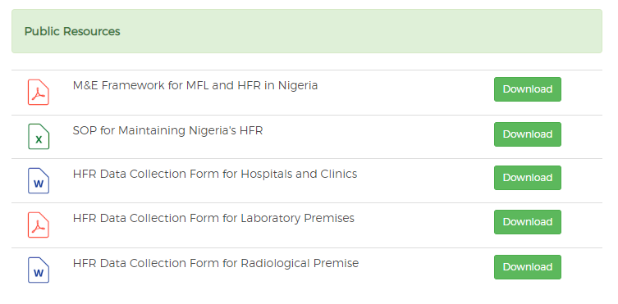
Resources
If you are looking for an MFL-related document, find the most current version available for download here.

Slide 35
Activity

Slide 36
Group activity
Notes:
Ask for two volunteers to serve as judges
Divide the group into six equal groups
Name the groups: identity, location, contacts, status, personnel, services
Distribute a printout of slides 33–39 to the corresponding group
Ask each group to prepare a one-minute argument to argue for the importance of collecting their data set
The judges will award a prize to the most convincing group

